Slide 1
capam and account management integration
Summary of how Account Management and capam(CA Privilege Access management) work together

Slide 2
Why CAPAM?
Secure application/system accounts requiring user access.
Automatic password rotation/management.
Audit Tracking/Review.
2 Factor authentication to access resource.
24/7 Support for access issues (if applicable)

Slide 3
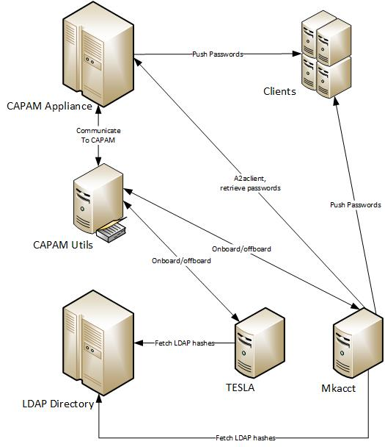
CAPAM/Account Tool Overview
Onboarding/Offboarding refers to Adding/Removing servers and accounts to/from the CAPAM appliance.

Slide 4
Mkacct configuring
Mkacct will not work with CAPAM material until the SA/Admin turns it on.
Automation scripts are in place to make the process almost fully automated.
CAPAM uses a filter in Mkacct, so process to add account to CAPAM similar to how LDAP accounts are added.
AD Groups are required when using CAPAM on servers.
A service account is added with sudo rule to manage passwords.
Night cron makes sure any CAPAM changes in Mkacct are in sync with CAPAM.
If CAPAM becomes unreachable, for any reason, Mkacct will continue to function, and will default passwords to the cluster name until the connection is restored.
Refer to the documentation on the Grunt site for very detailed information on everything above, which are at the end of these slides with the URL.

Slide 5
CAPAM UTILITY Site – What is it?
This site act as a “proxy” between Mkacct and CAPAM. This site serves 2 main functions:
Track servers/accounts that need to be added/removed
Secure access to the CAPAM Appliances
Rest Calls are made via Mkacct/tesla to this site to check/make updates.
Rest Calls are made to the CAPAM appliance to work request.
Can search the site to find AD Groups, Servers, and accounts being mapped.
URL ( https://capamutils.prod.fedex.com )

Slide 6
Capam Usage
Download CAPAM UI
Search for target Server/create custom controls.
Open SSH terminal access for any account, or retrieve root(only root account) password directly
Checkin/Checkout the account/password.
Refer to links at end of slide for detailed information on these steps.

Slide 7
Caveats – Performance issues
Onboarding/offboarding servers/accounts is a very slow process. The more servers/accounts to onboard, this time increases. Roughly 15 seconds to onboard one server/one account, so you can do the math.
CAPAM UI has a 90 day inactive access limit. If you have not logged into the UI, you will be required to open a request to Infosec to have your account activated again.
Automation has not been fully implemented, onboarding requires email to be sent to Infosec for new clusters/accounts. Removal of accounts/servers will not be removed from CAPAM.
Mkacct servers require java on them now to run the a2aclient, which can cause discovery to note out of compliance java versions.

Slide 8
Roadmap forecast
Roadmap is subjective to Infosec timelines and SA/Admin of Mkacct schedule, the tools team will be providing the support for the migrations, but not enforcing the migration timeline.
Upgrade Mkacct’s with the new code base.
Get all pci in-scope servers on boarded first.
Onboard all other servers after security servers have been on boarded.
Create “Jump” servers for bulk updates that are needed.
Remove ssh keys access to accounts that are on boarded.
Remove Sudo Rule access to log into accounts.

Slide 9
How to get more help
More information on the CAPAM UI:
https://grunt.sac.fedex.com/doc/PamJobAid.pdf
More information on Configuring Mkacct
https://grunt.sac.fedex.com/caPamFAQPage.cgi
More information on configuring Mkacct clusters
https://grunt.sac.fedex.com/caPamFAQPage.cgi#MKACCTUSAGE
24/7 CAPAM Support:
Immediate/Emergency: pam-oncall-beeper@corp.ds.fedex.com
Normal Business Hours(8 - 5) CST: pam_support@infosec.fedex.com

